Slide 1
Jack of all trade universe
Online community marketplace
Community currency
Presented by Jamie klinger

Slide 2
Table of contents
Inspiration (Oct 2012)
Pocket Explanation
Development (June 2013)
Beta Structure (Feb 2014)
Direct Democracy Currency Generation
Bitcoin and Cryptocoin Implementation (April 2014)
Future of JoatU (Beyond 2014)

Slide 3
Inspiration October 2012
Jack of all trade universe

Slide 4
Inspiration
Nobody was offering the job I wanted!

Slide 5
MISSION
The Jack of All Trade Universe strives to provide a robust platform of value exchange for the individual while simultaneously promoting community centered activities through a direct democracy inspired decision making model.

Slide 6
VISION
To build an economy that seeks to promote human welfare.

Slide 7
Pocket Explanation
Jack of all trade universe

Slide 8


Slide 9
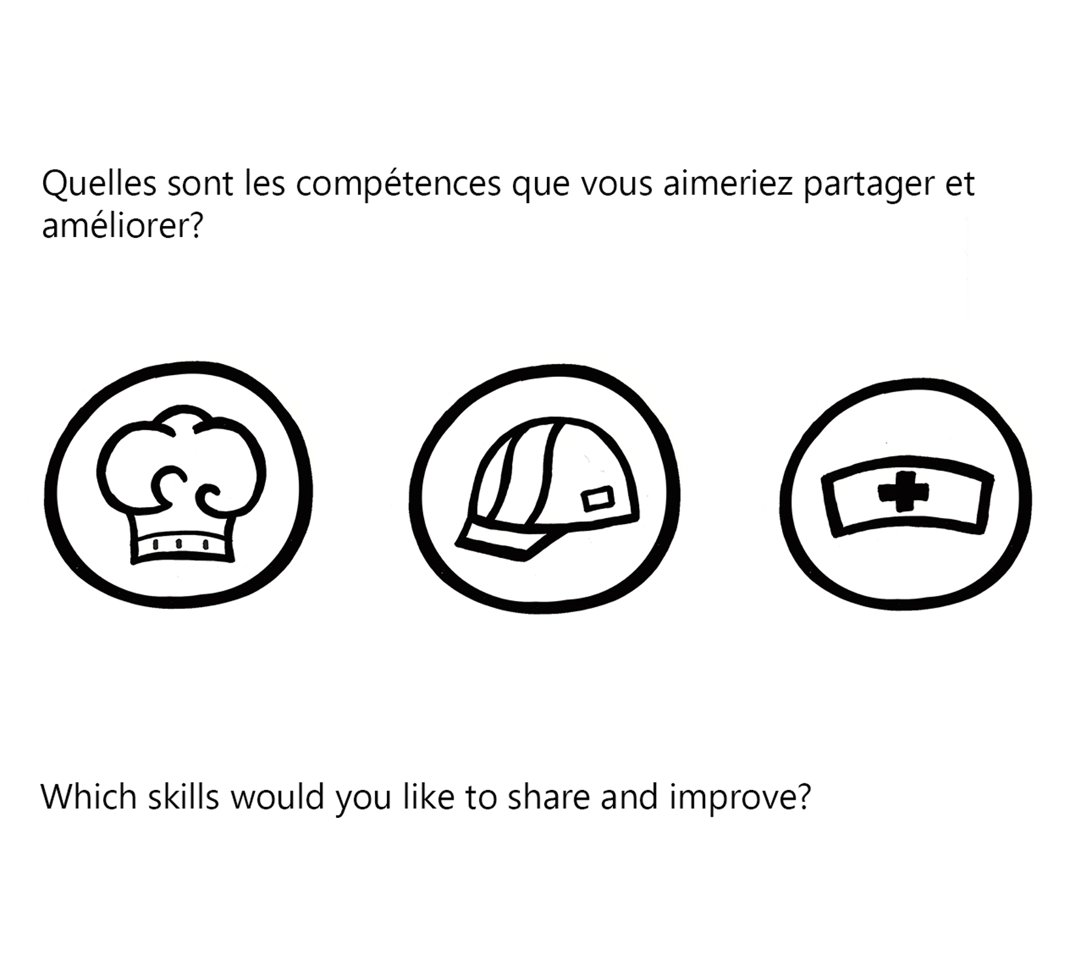

Slide 10
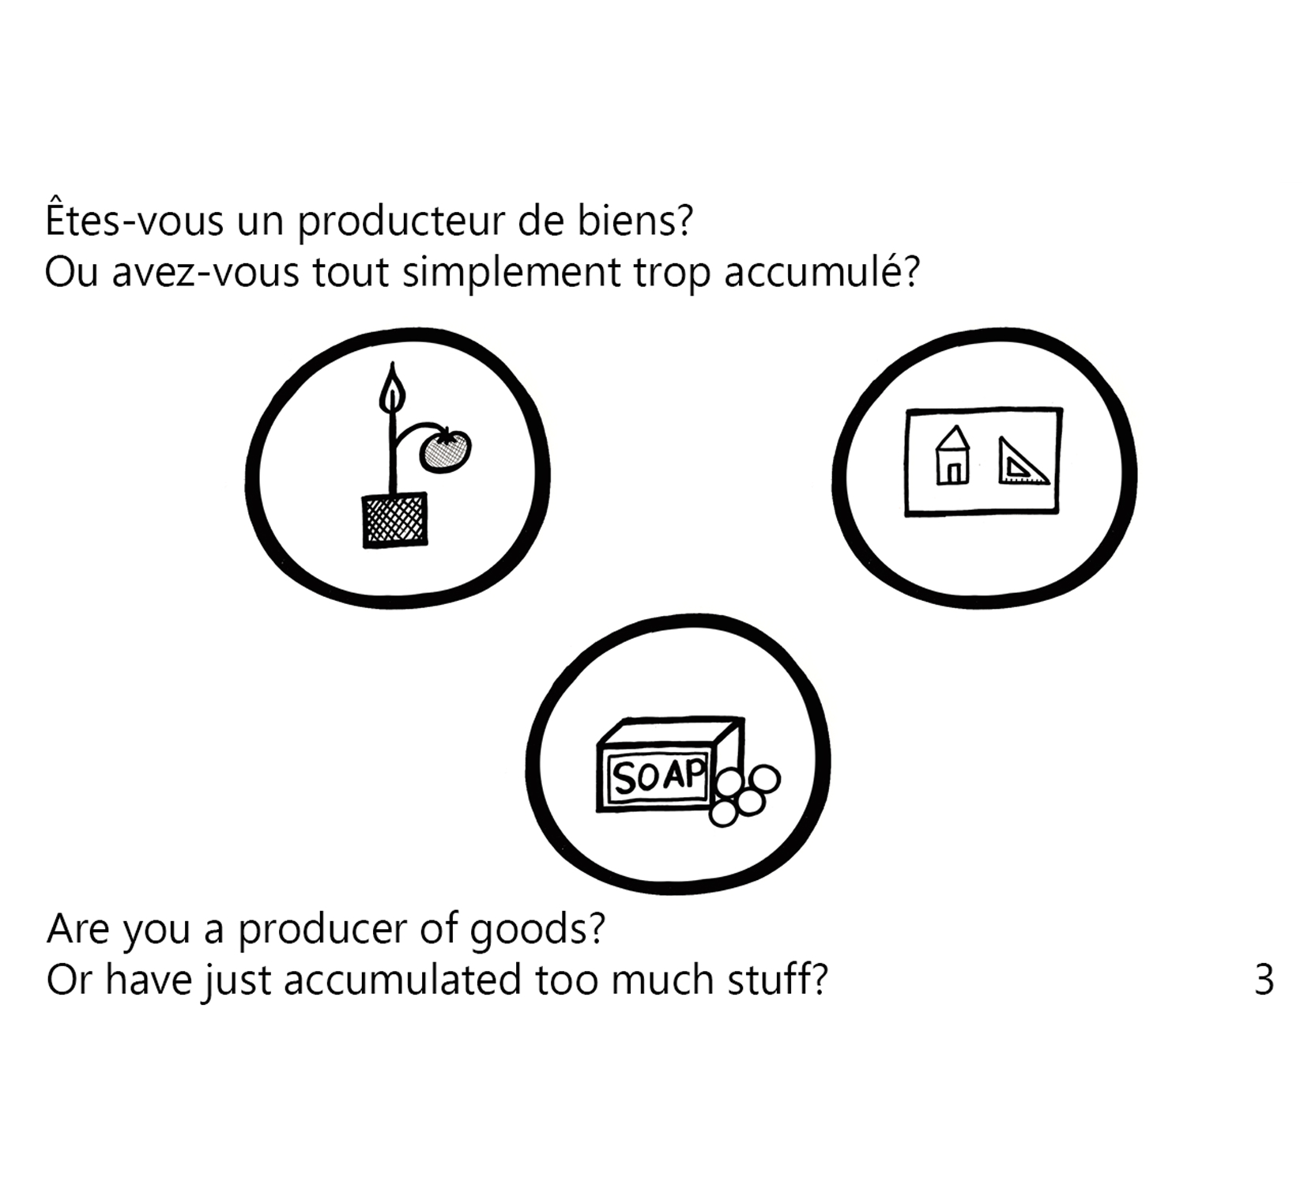

Slide 11
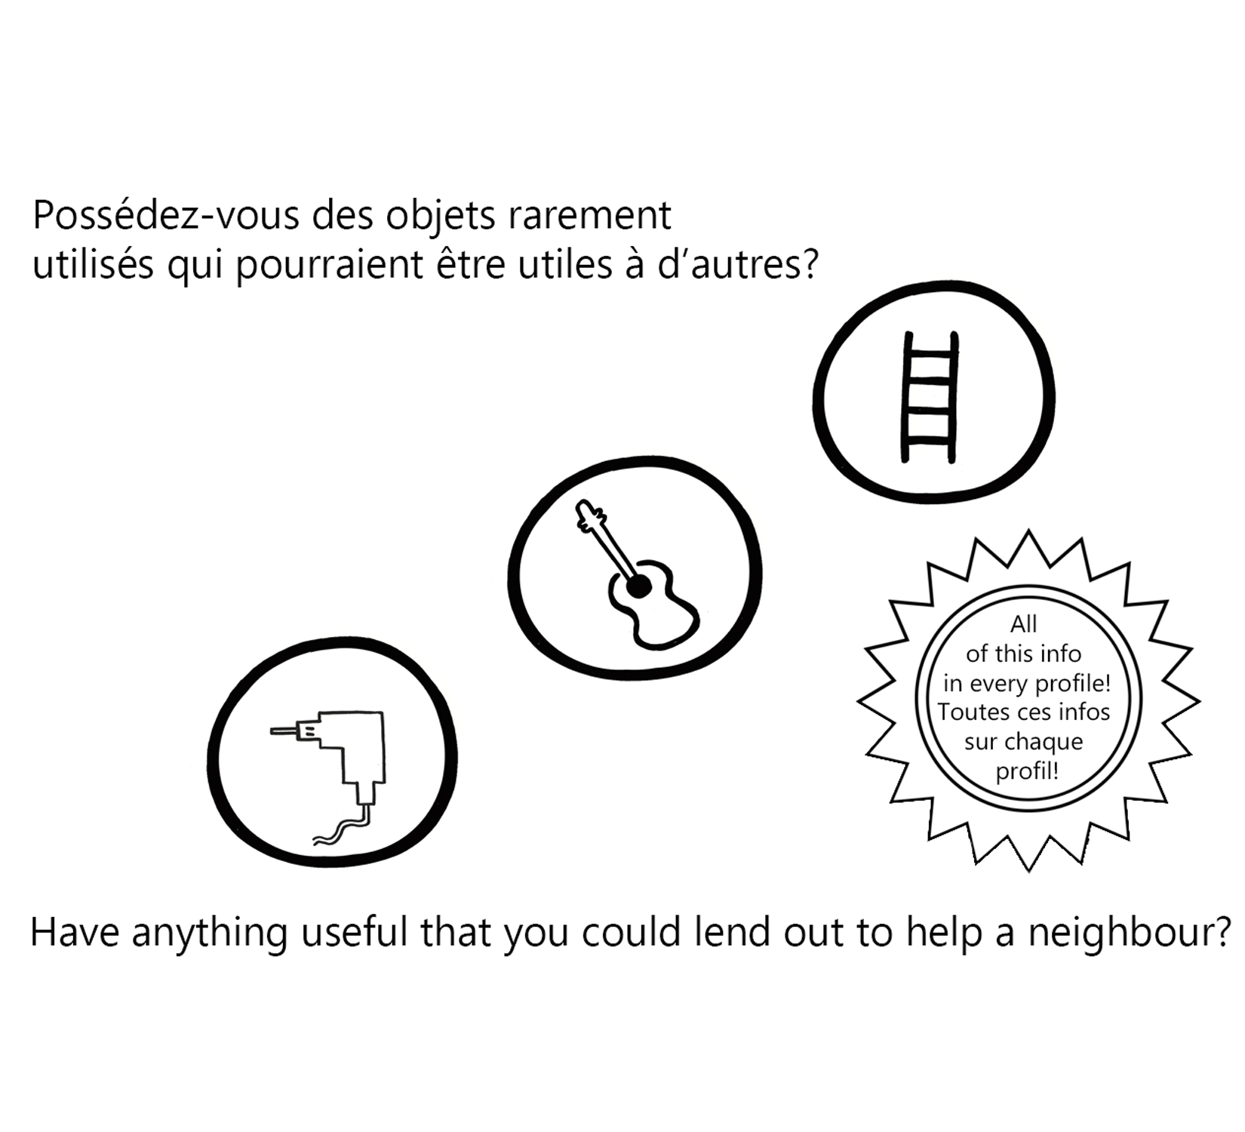

Slide 12
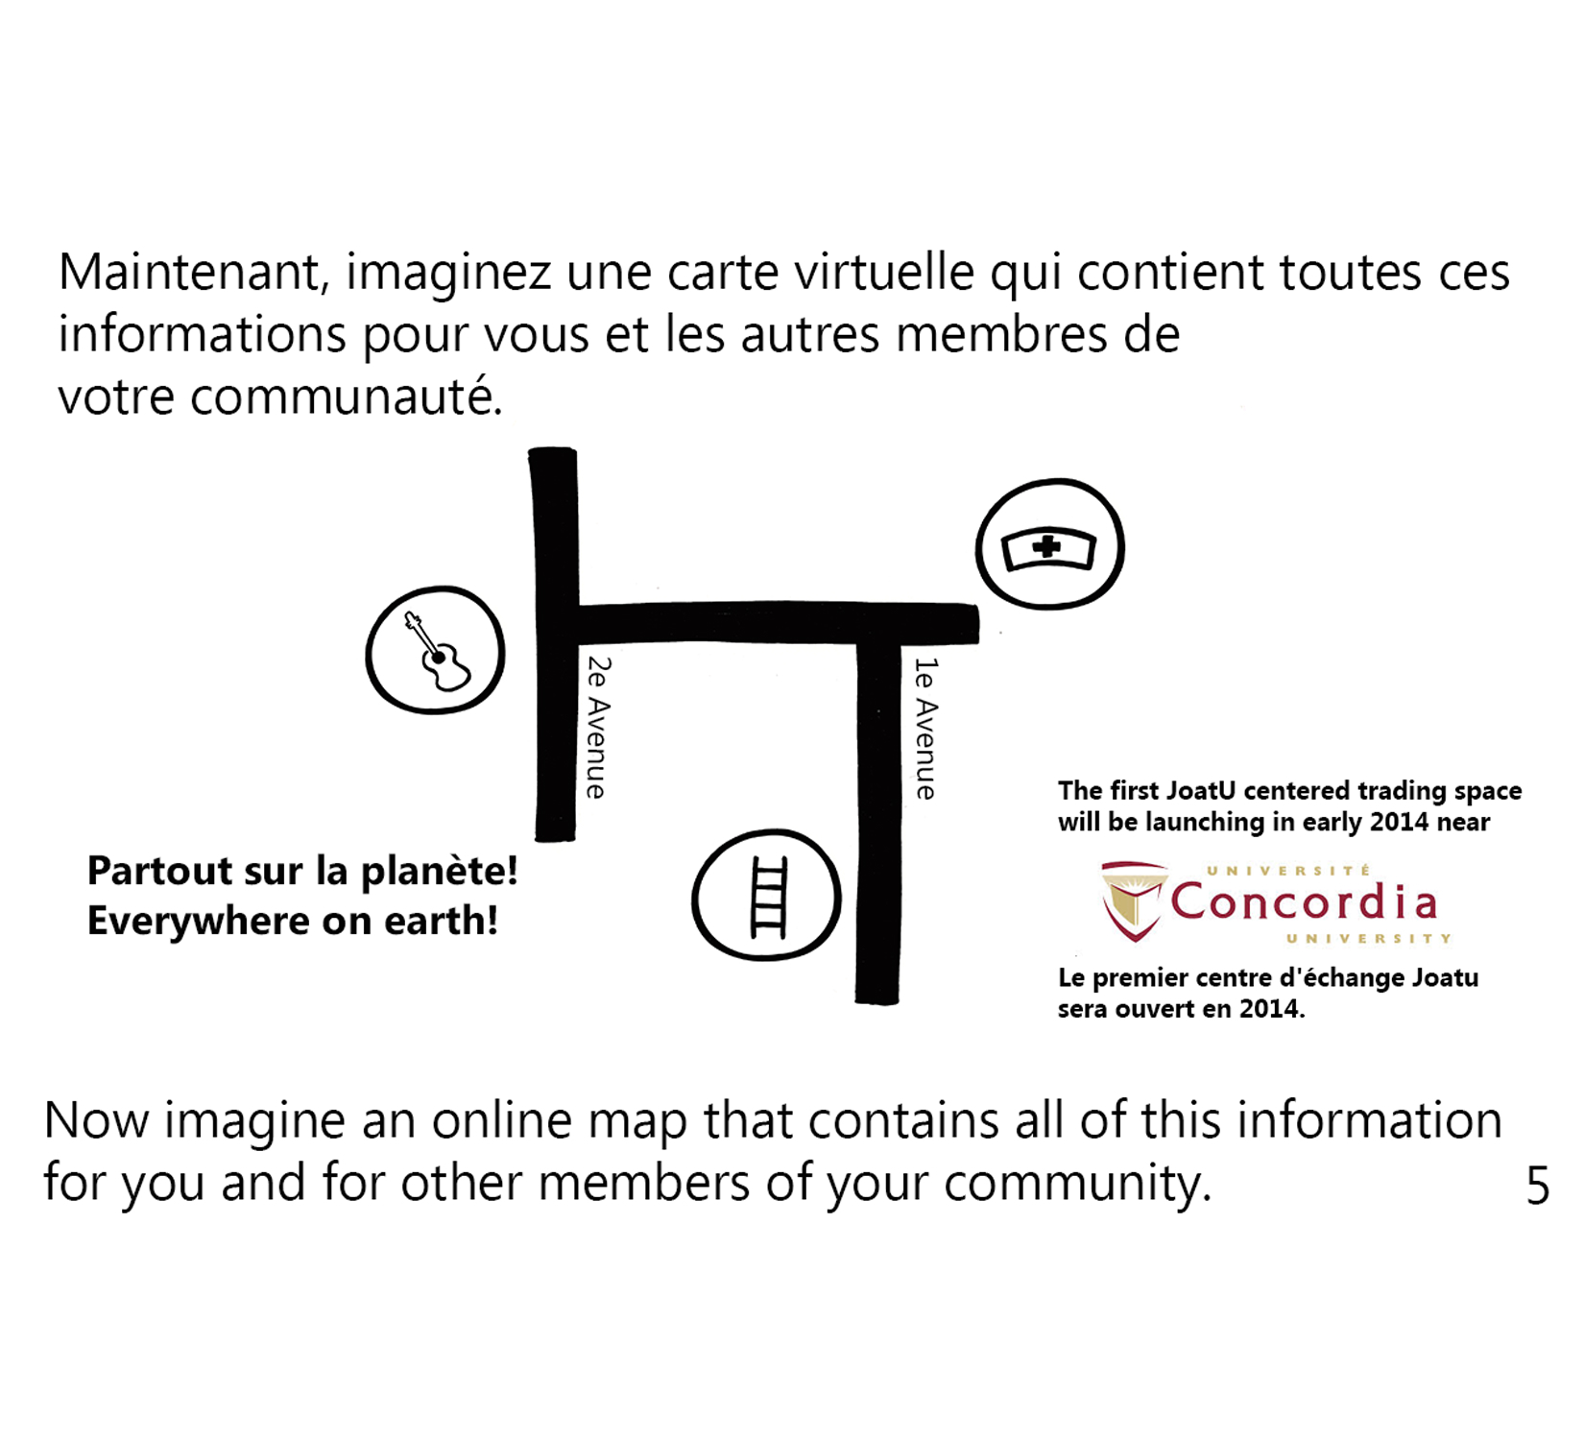

Slide 13
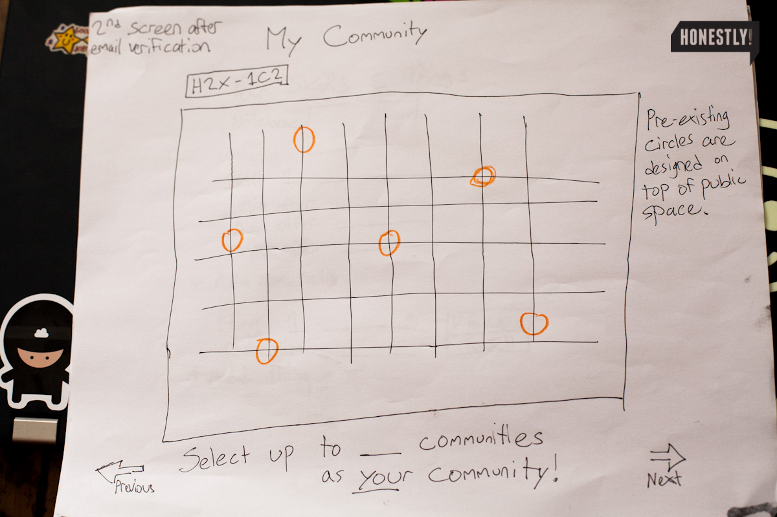
Outside Communities
Main Community
Extended Communities

Slide 14
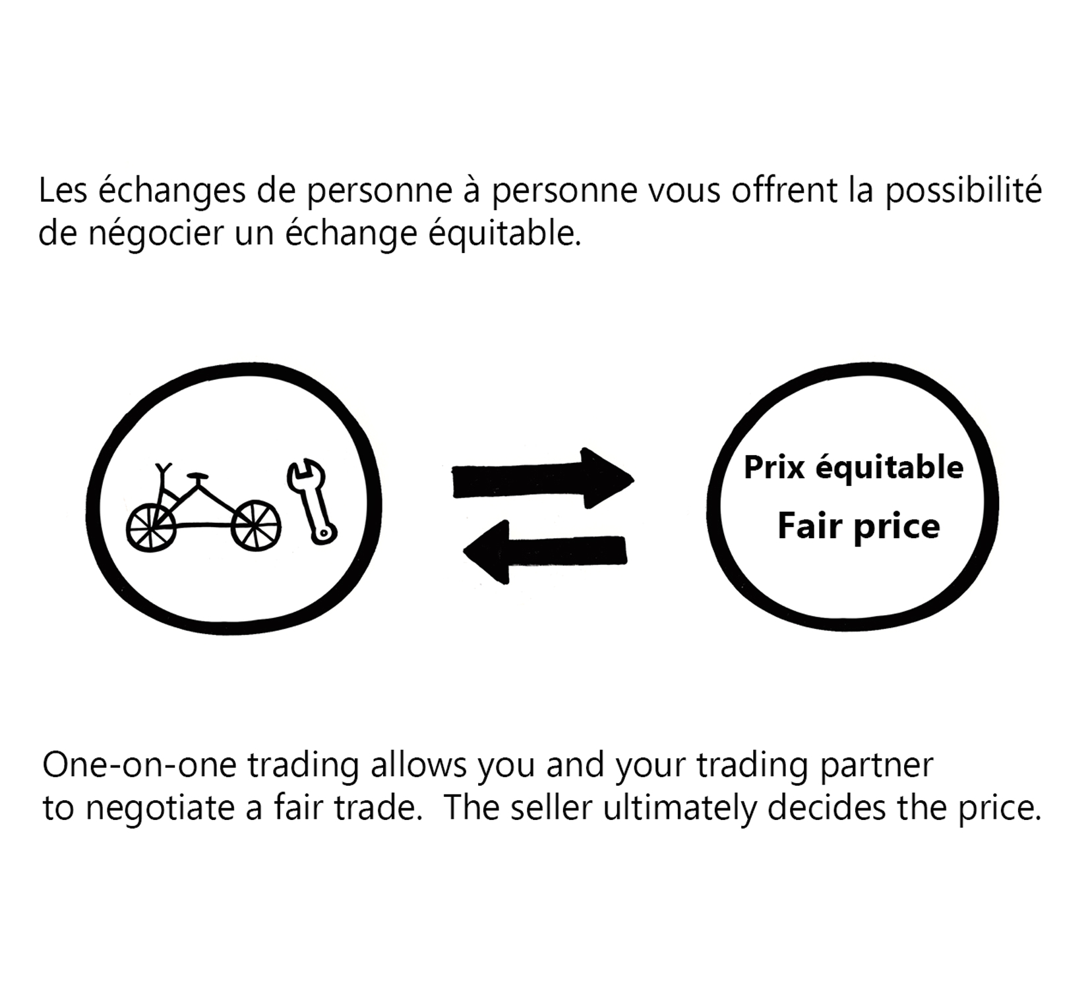

Slide 15
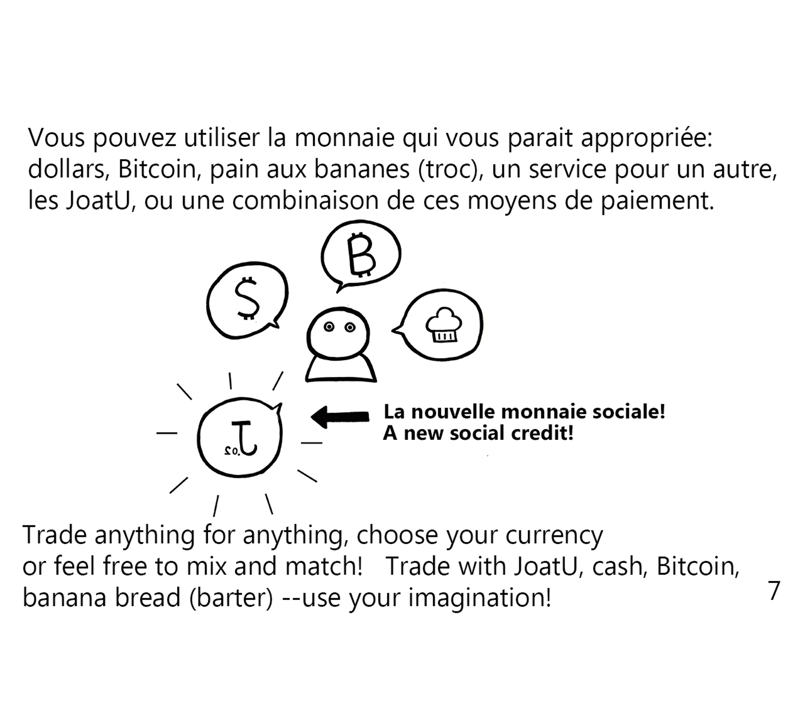

Slide 16
Individual Offers anything for anything (Barter or cash)
Sell
Rent
Trade
Donate

Slide 17
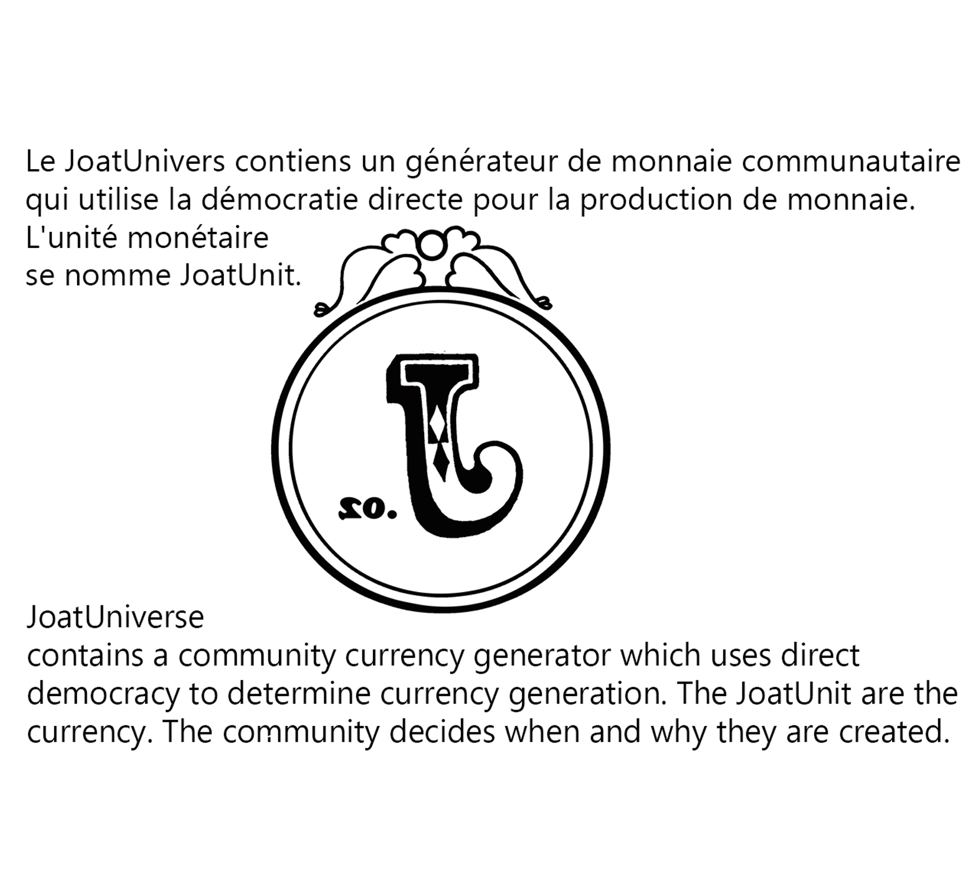

Slide 18
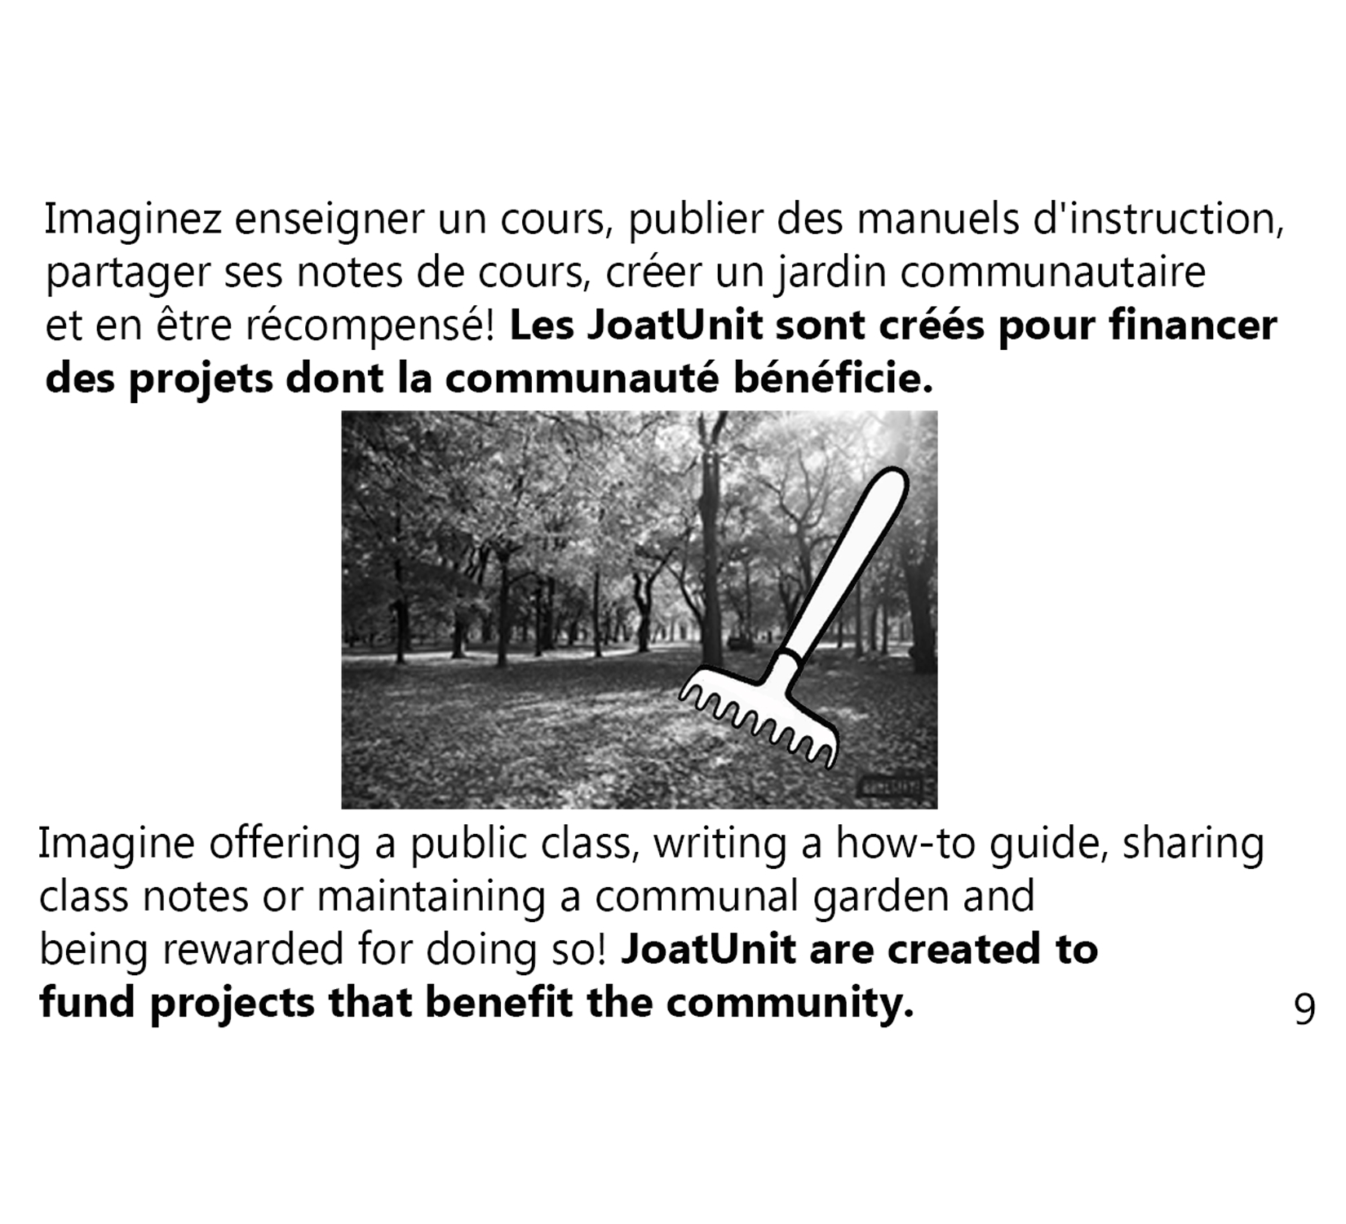

Slide 19
Joatunit for Community offers
JoatUnit is generated through the community offer process
It is a currency with:
Permanent 0% Interest-rate
Inflationary - unlimited supply of JoatUnits that can be generated
Incentive to spend/Increased exchanges
Incentive against hoarding

Slide 20
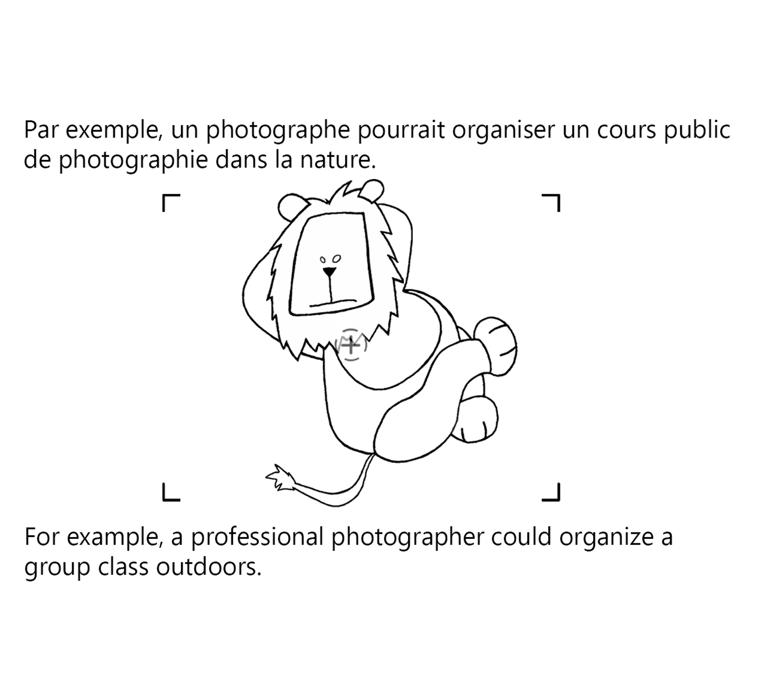

Slide 21
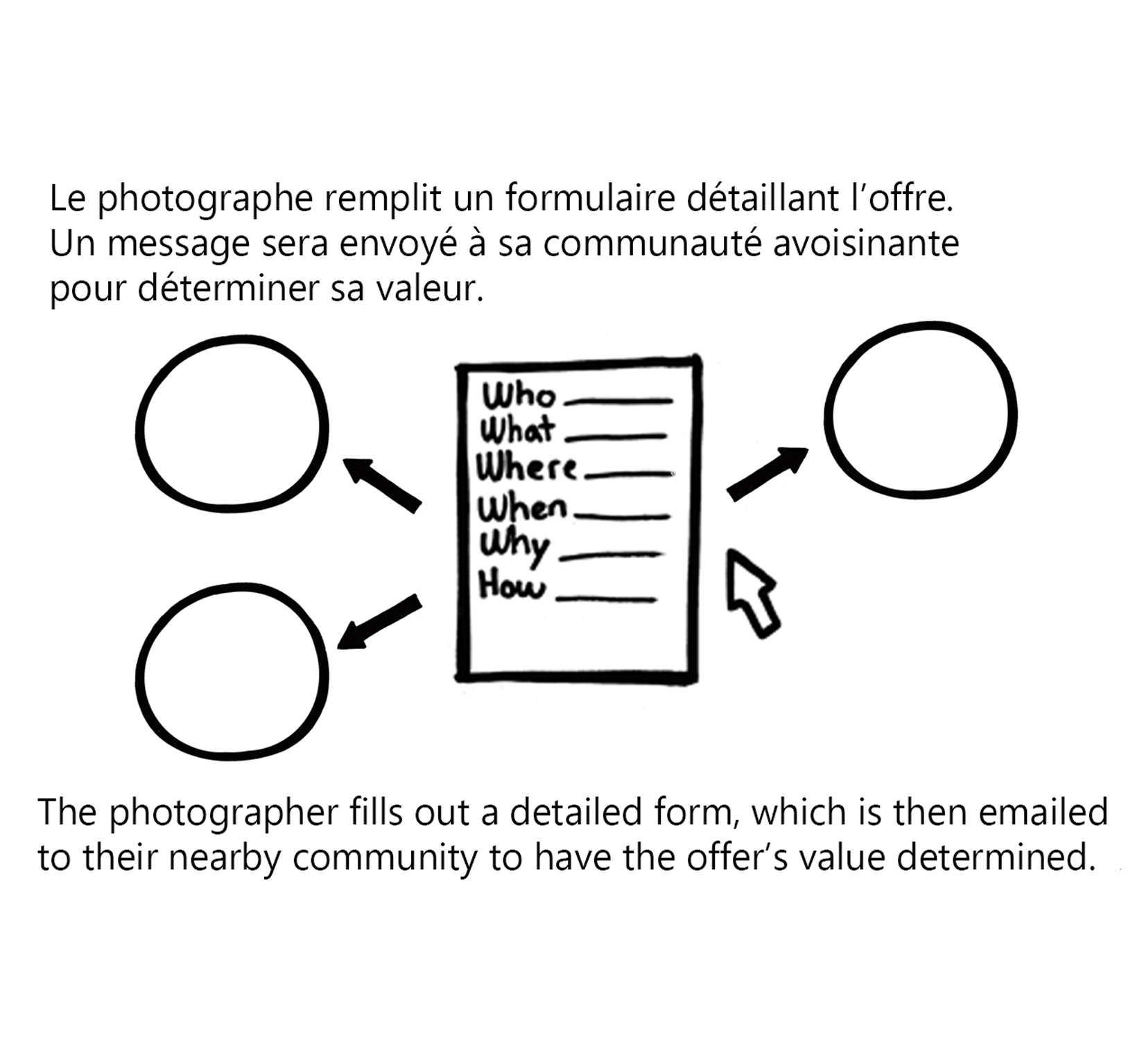

Slide 22
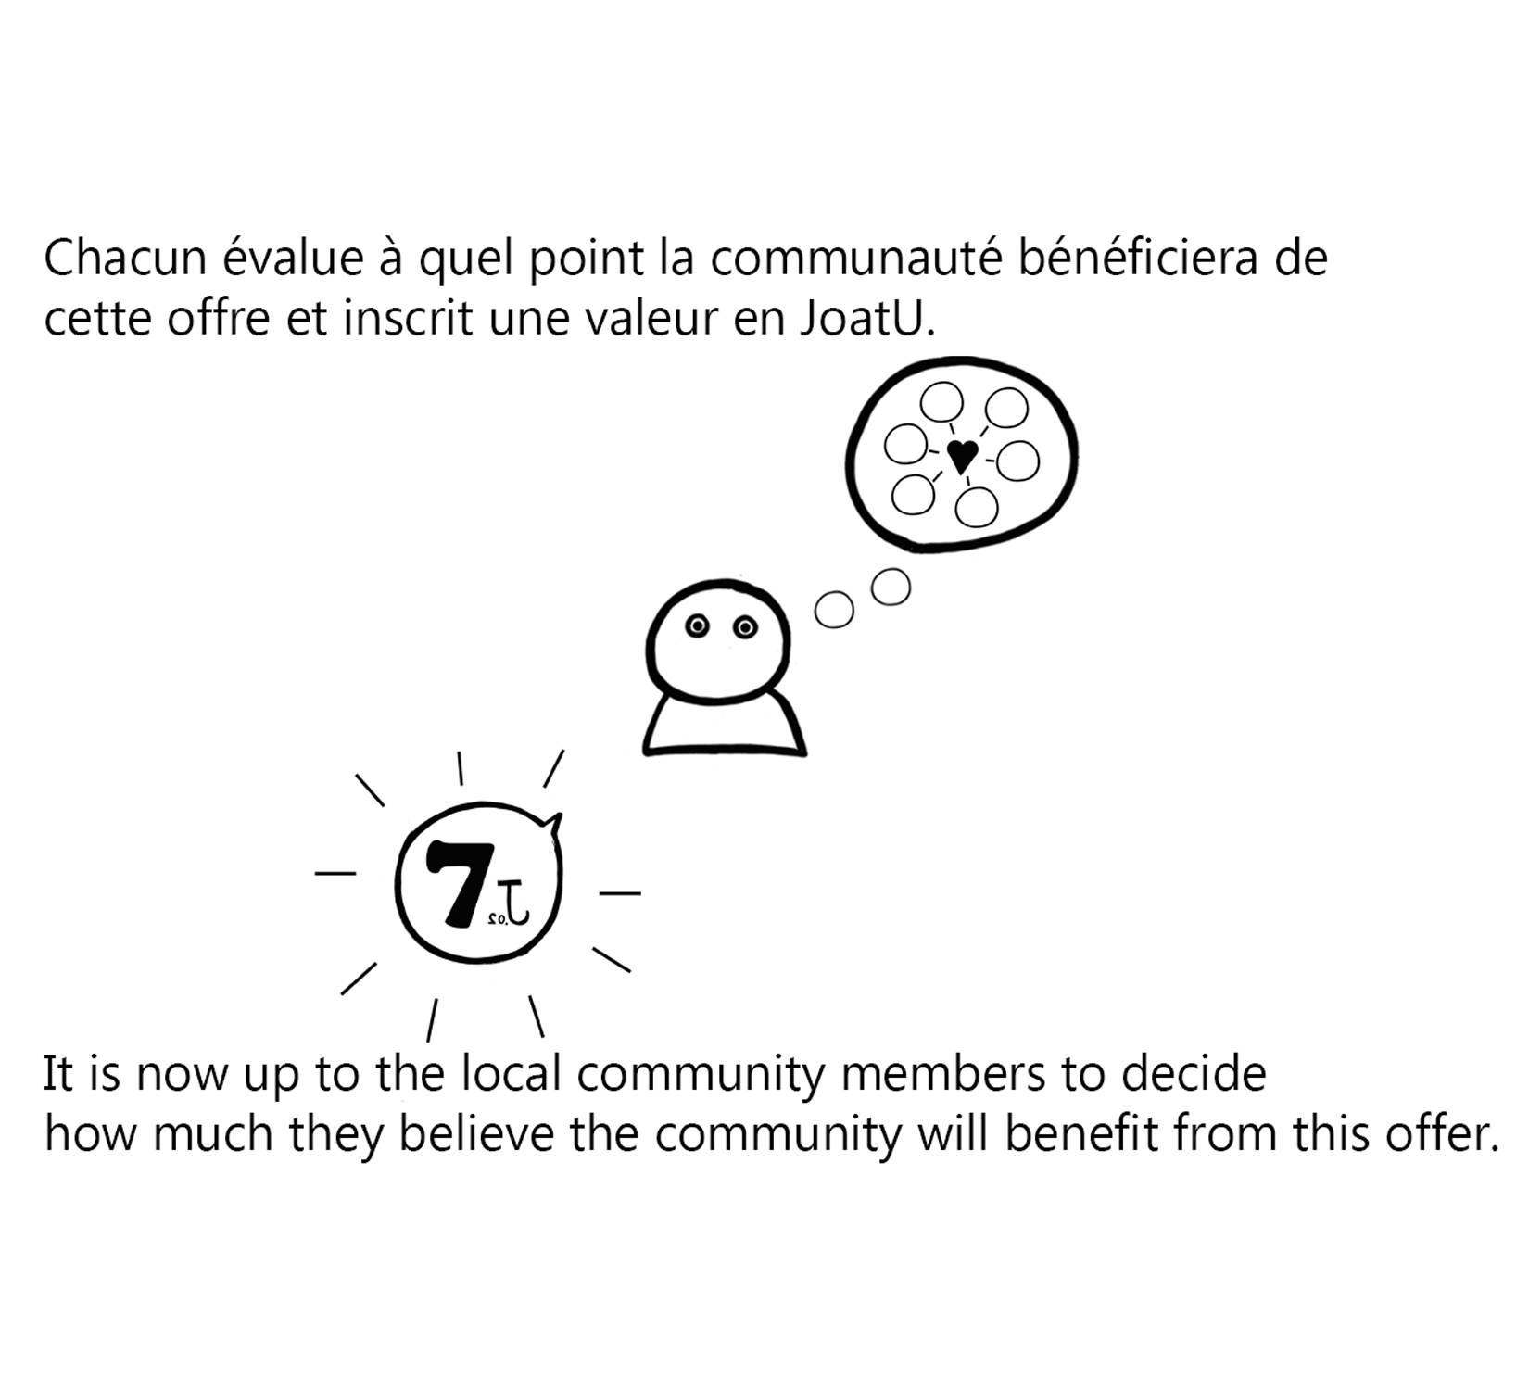

Slide 23
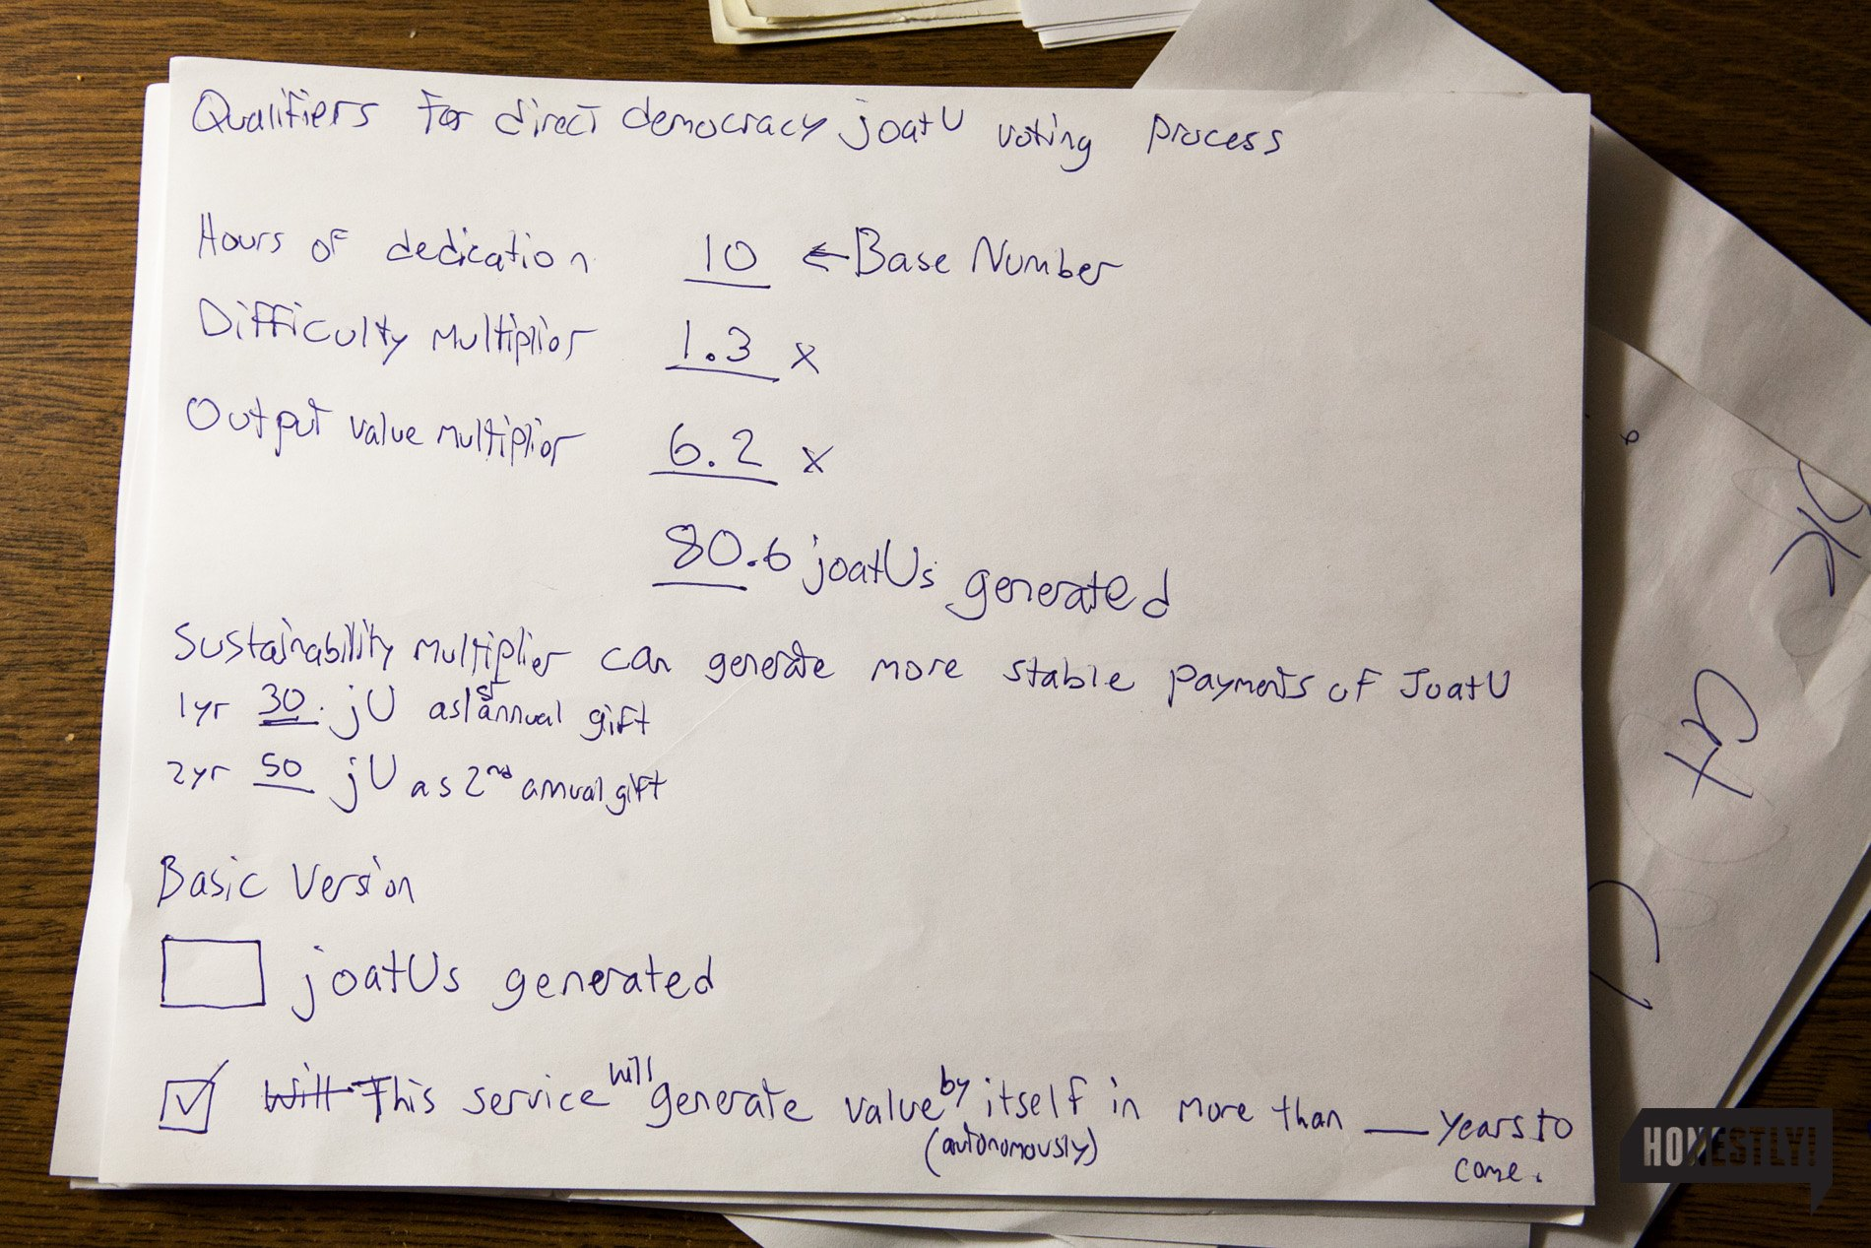
How Value can be determined

Slide 24
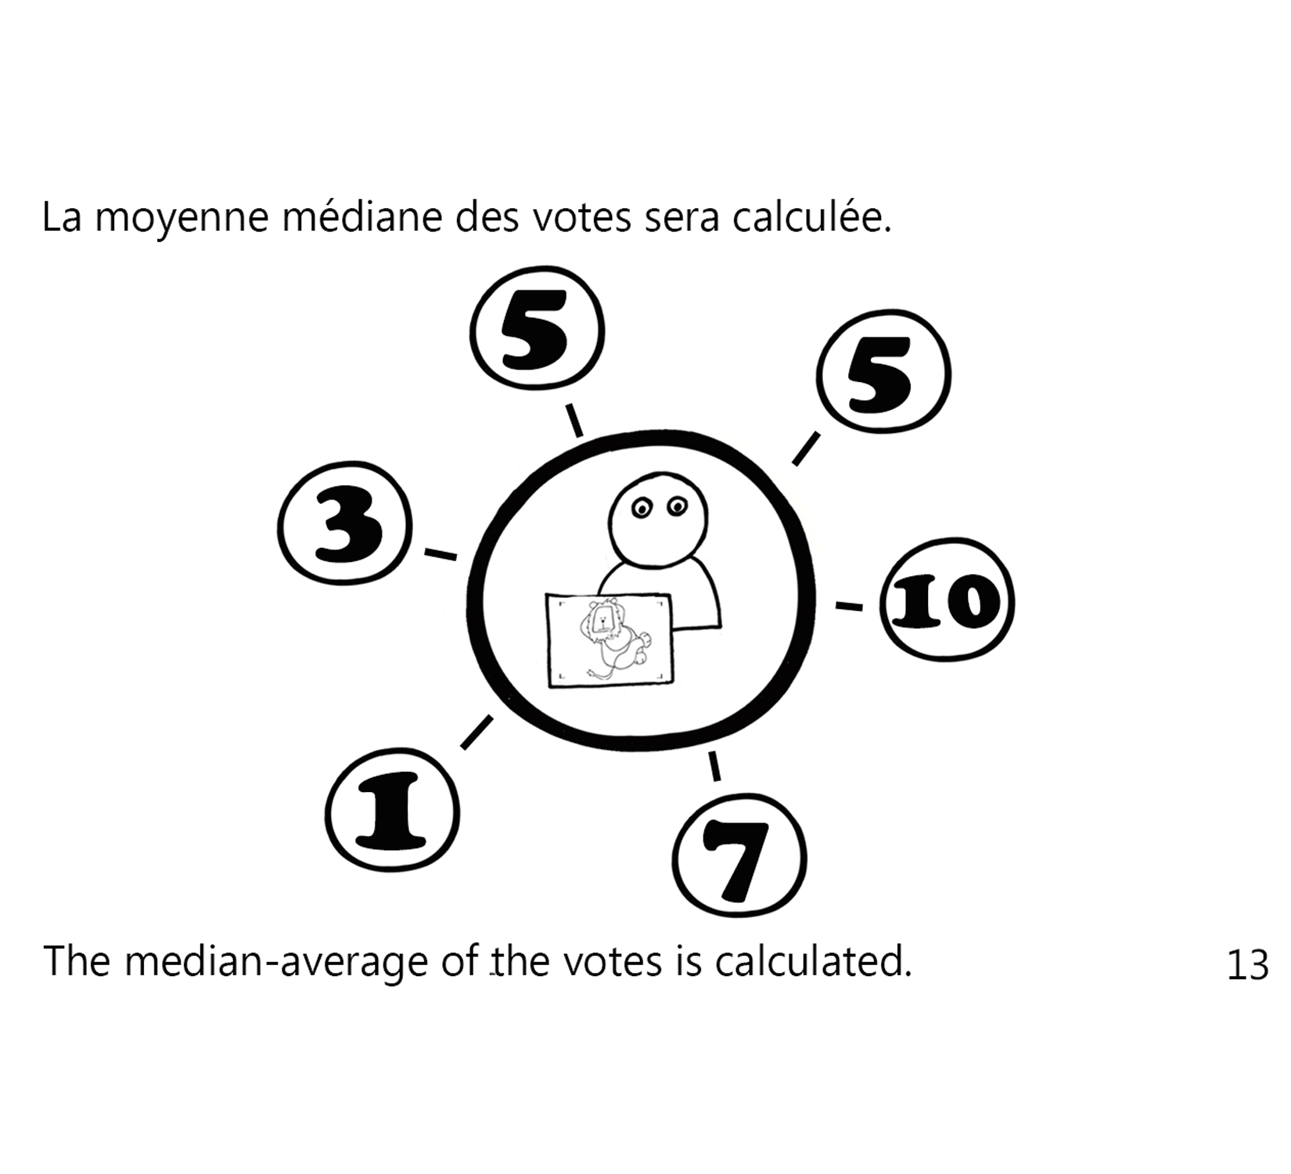
This process does not cost the voters anything!

Slide 25
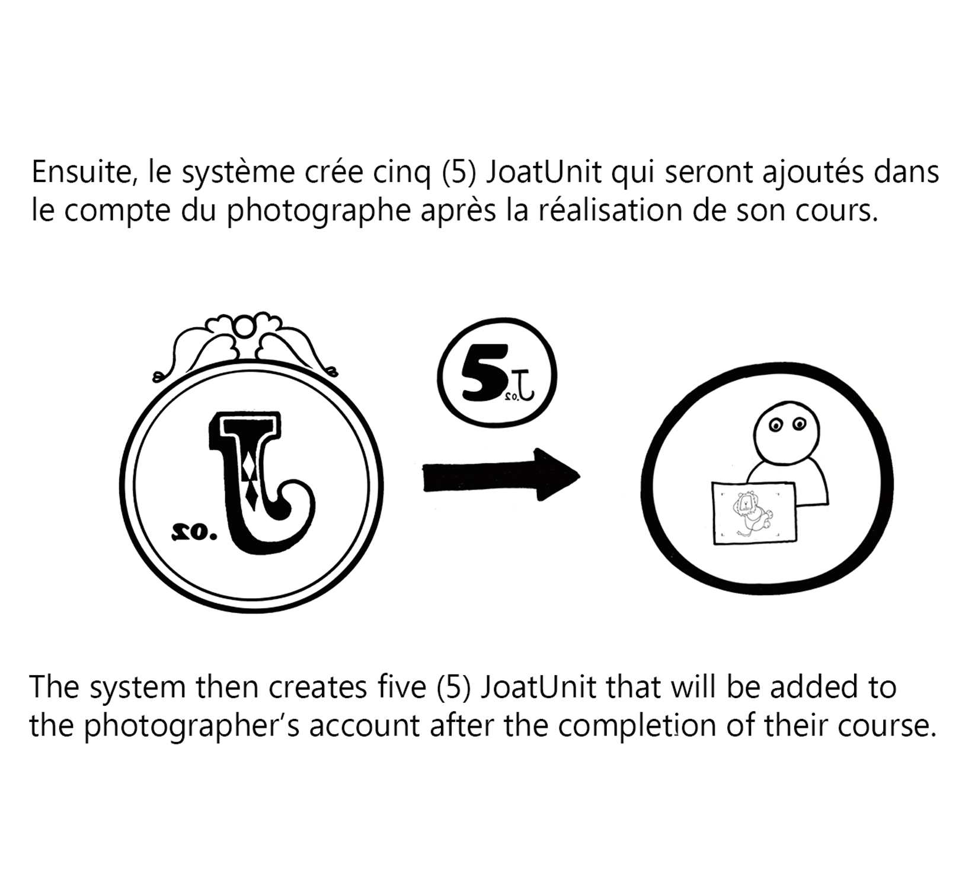

Slide 26
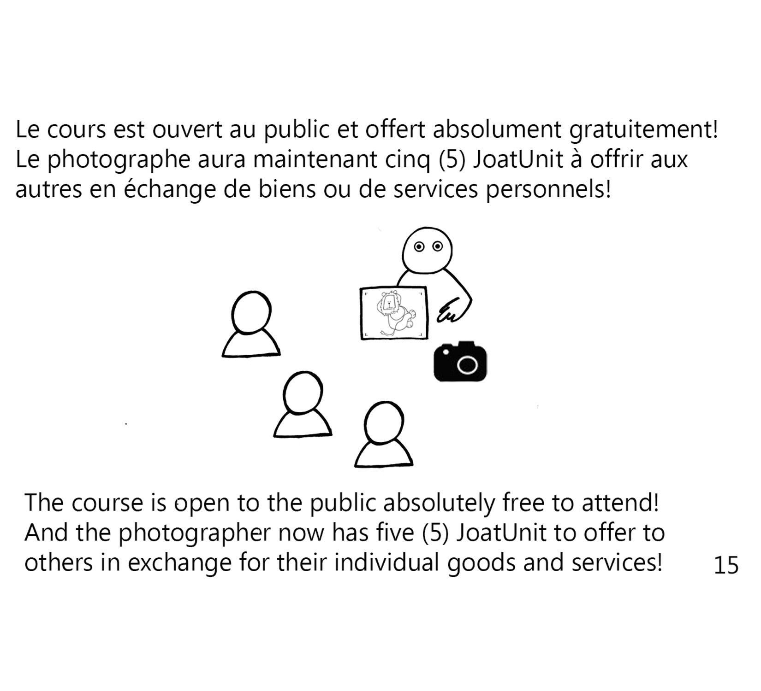

Slide 27
Direct Democracy Currency Generation
Jack of all trade universe

Slide 28
Direct Democracy Currency generation
Parameters
200 users minimum per community
1-3 days voting window
Needs % of population for vote to pass

Slide 29
Direct Democracy Currency generation
Process
One community offer for a garden is submitted (it will take 10 hours)
100 people vote on its value (or value per hour)
Votes are ordered from smallest to largest
Votes numbered 45-54 are extracted, added together, and divided by 10
Units placed in escrow awaiting confirmation & task completion

Slide 30
Direct Democracy Currency generation
Security
Only people who have received X references can vote
Only people who have traded Y times can vote
Vouch-type system comparable to Couchsurfing
Keyhotee Integration for unique decentralized IDs

Slide 31
Direct Democracy Currency generation
Securing Value in Inflationary Currency
Maximum multiplier: 10x
Or
Inter-JoatU exchange rate based on currency output per unique community

Slide 32
What can joatu beta hope to accomplish?
Underemployed/Unemployed become part-time freelancers
Increased security within communities by knowing one’s neighbors
Makes people feel useful, gives people meanings
Hyperlocal comprehensive listing of goods/service

Slide 33
What can joatu beta hope to accomplish?
Free education with paid (in JoatUnit) teachers
Promotes skill acquisition/diversification and learning
Paid guerilla gardening to generate public food throughout the city
Community-centric creativity to continually generate new value within the community

Slide 34
Development June 2013 - Present
Jack of all trade universe

Slide 35
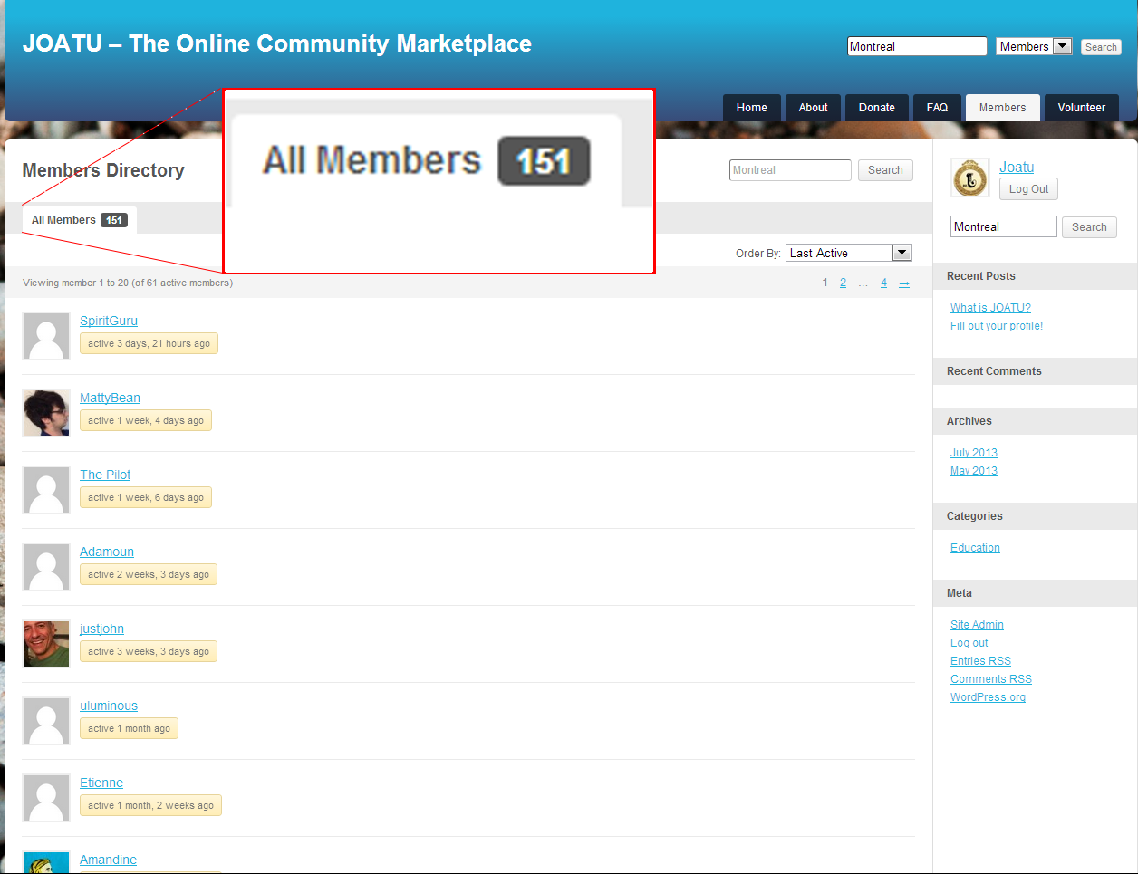
Wordpress launched
- 151 Members
- 60+ in Montreal
- 638 likes in Facebook
- 181 followers on Twitter

Slide 36
All volunteer team
3 programmers working in Django (and with Twitter Bootstrap)
1 Business/Community Organizer as a volunteer from Community School of Public Affairs
15 volunteers who have already helped significantly advance JoatU
List of 50 contacts willing to help in their respective fields when needed

Slide 37
Beta (Feb 2014)
Jack of all trade universe

Slide 38
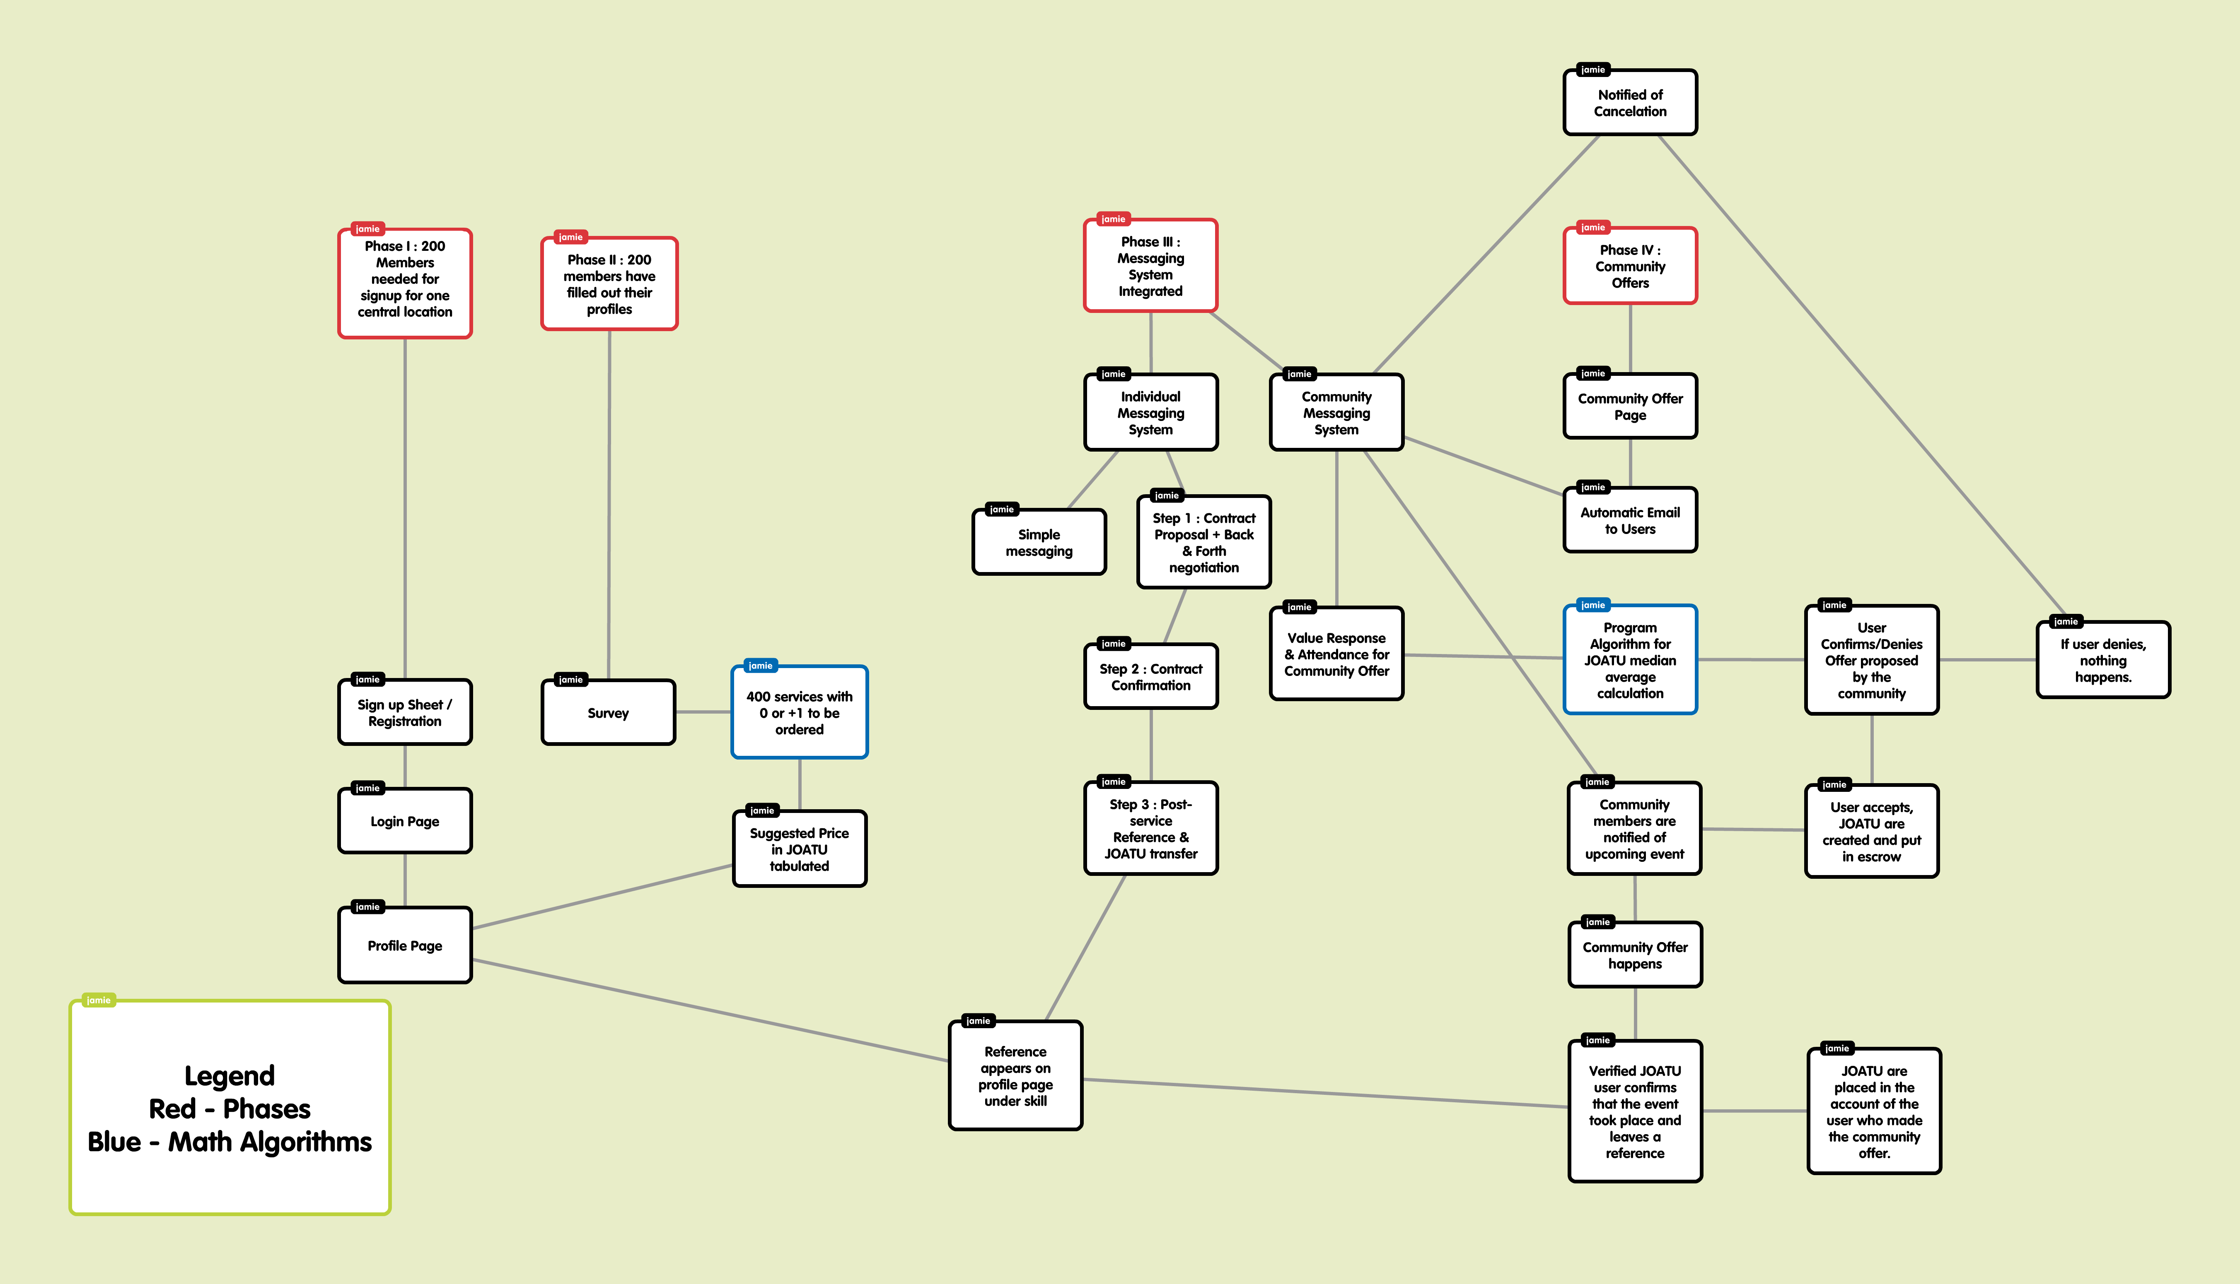

Slide 39
Beta – Phase one Find 200 hyperlocal users
Registration Page
Login Page
Profile Page

Slide 40
Beta – Phase Two 200 users filled out their profiles
25 “this” or “that” preference questions/user
Determines communally suggested JoatUnit value
1 hour of event photography as compared to
1 hour of dishwashing

Slide 41
Beta – Phase Three The site is now functional for Interaction
- Suggested pricing is now listed on profiles
- Messaging is functional
- Trading/Contract system integrated into messaging
- Reference system is operational to leave feedback

Slide 42
Beta – Phase Four community offers & currency generation
Community offers for JoatUnit currency generation

Slide 43
Bitcoin/Cryptocoin Implementation April 2014
Jack of all trade universe

Slide 44
Bitcoin
Low cost value transaction protocol
Crowdfunding for individuals and communities
% of donations made to JoatU in Bitcoin to be governed through direct democracy voting

Slide 45
Colored coins / bitshares
JoatU’s physical goods get digital deeds
Colored coin is stamped as a digital coupon for one of “Jamie’s famous batch of chocolate chip cookies”
RPG-styled inventories
Global trading possibilities decentralized from JoatU

Slide 46
Cryptocurrency integration
Centralized JoatU forks into a decentralized (and open source?) mathematically accountable cryptocurency
Low-cost value transaction protocol
Democratically decided upon coin regulations

Slide 47
Cryptocurrency integration
JoatU dividend against donations (e.g. 5% of all JoatU created/annum are reserved to be distributed among members who donate in Bitcoin)
A percentage of JoatU generated for the miners/verifiers of the chain and a % of JoatU for people who donate in Bitcoin to help the system run
Demurrage possibilities like Freicoin

Slide 48
Future of JoatU Beyond 2014
Jack of all trade universe

Slide 49
Future of joatu
Direct Democracy evolves into Liquid Democracy integration for voting within cities/deferred decision making/representative democracy
Every member is a potential elected official
Technocratic approach
Improved efficiency and representation in governance through direct-democracy and money-creation
Money creation on demand and based with reputational values for reduced waste
Meritocratic approach

Slide 50
Future of joatu
Welfare-state-like protection of individuals living within your community including retirement programs
Community & Inter-community self-sustenance
Global Network of JOATU communities that can transfer goods, services, and knowledge between each other.
Borderless direct-democratic world governance through a bottom-up community-centered perspective with a focus on global environmental sustainability and egalitarianism.

Slide 51
You just sat through 50 slides

Slide 52
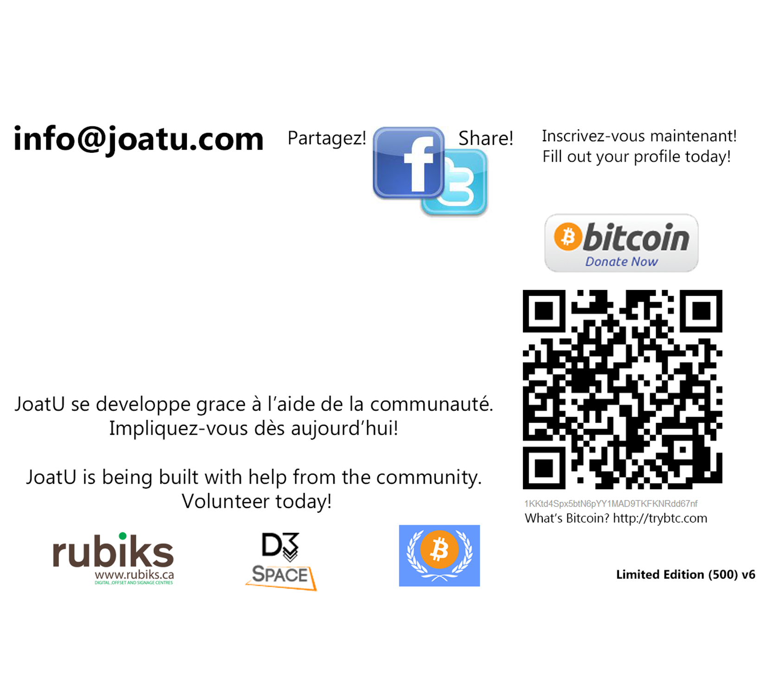
THANK you!

